Slide 1


Green Grains, Strong Chains:
Innovative supply chain solutions for
climate-vulnerable farming in India
Amith R – GS25MTECH11110
Desai Haet Rupeshkumar – GS25RESCH11002
Maitrey Patankar – GS25MTECH11105
Under the Supervision of Dr Ambika S

Slide 2

The Challenge: India's Agricultural Crisis
Staggering Losses
Vulnerable Infrastructure
India loses ₹1.5 lakh crore ($18.5 billion) annually in post-harvest losses—74 million tonnes of food wasted each year, representing 22% of foodgrain output.
60-70% of food grains stored in traditional structures offer limited climate resistance. Storage moulds thrive at 20-40°C with 70%+ humidity—conditions increasingly common due to climate change.
Climate change intensifies these challenges through erratic rainfall, rising temperatures, and extreme weather events, disrupting traditional agricultural systems.
There’s no dedicated framework to monitor the whole supply chain and the carbon emissions from it. This presentation gives a basic concept of how the new framework should be formulated and what things can be incorporated.

Slide 3
Literature Review Table
Sr. No | Authors & Year | Title/Focus | Research Area | Key Findings | Methodology
1 | Wood (2020) | Singapore Urban Agriculture Model | Urban Farming Systems | Vertical farms use 90% less water; rotating towers with 38 tiers. | Documented design and operation of rotating tower systems; measured water consumption and yield per tier; surveyed operational challenges in urban settings.
2 | Schreefel et al. (2022) | Agricultural Export Performance Analysis | Global Agricultural Trade | The Netherlands is the world’s second-largest food exporter despite small land area. | Performed export data analysis using FAO and UN COMTRADE statistics; correlated export volumes with technological adoption indices; assessed trade balance impacts.
3 | Kumar & Agarwal (2024) | AI-Based Quality Supply Chain Architecture | Quality Assessment Supply Chain | AI-vision achieved 88.4% detection accuracy, reducing post-harvest losses by 10–15%. | Designed 3-layer CNN for tomato grading; integrated across supply chain stages; used PSO for hyperparameter tuning; evaluated performance ground-to-retailer.
4 | Okolo et al. (2017) | Cocoon Storage: Alternative Pest Control | Cocoon Storage Technology | Hermetic storage achieved 100% insect mortality and preserved grain quality. | Deployed 100 MT hermetic storage; monitored moisture, protein, carbohydrate, and energy metrics over 2 years.
5 | Kumar et al. (2022) | Bio-CO₂ in Wheat Storage Pest Management | Bio-Carbon Storage Technology | Bio-CO₂ achieved 100% insect mortality in 1–5 days, preventing 17–27% weight loss. | Exposed wheat to 40–80% CO₂ from bio-waste gas; measured insect mortality, germination, weight loss, and nutrient content over 2 and 6 months.

Slide 4
Research Gaps
Holistic Evaluation of Climate-Smart Agriculture & its Transferability to India - Lack of systematic frameworks to evaluate the transferability, socio-economic feasibility, and holistic impacts of international climate-smart agricultural models when adapted to India’s diverse agri-climatic and socio-cultural contexts.
Bridging Climate Resilience and Low-Carbon Farming in India - Most studies focus either on the impacts of climate change on agriculture or on reducing GHG emissions from farming, but rarely integrate both. Our study bridges this gap by addressing adaptation and mitigation together within the Indian context.
Sustainability Pressures and Carbon Footprint Reduction - Lack of implementation of data-driven sustainability measures to monitor and reduce emissions across the supply chain. With the growing emphasis on sustainability, businesses must adopt greener supply chain practices.
Fragmented Supply Chains - Agricultural supply chains often involve multiple intermediaries, from farmers and processors to distributors and retailers. This fragmentation can lead to inefficiencies, a lack of transparency, and difficulty in tracking products.

Slide 5
Objectives
Identification of climate change risks to crop production, storage and logistics in India.
Review and selection of relevant foreign case studies (e.g., The Netherlands, Singapore, Israel etc.).
Transferability studies to Indian conditions.
Recommendation of actionable strategies for India.

Slide 6
Literature Review
It includes studying research papers, reports, and government project documents to extract: model description, climate benefit, yield improvement, cost/benefit details, supply chain and market linkage info, etc.
Selection and Description of Case Studies
Countries with similar climate, agro-ecological zones, and socio-economic conditions to India (e.g The Netherlands, Israel and Singapore) are selected.
Climate & Context Matching for India
Comparison of climate and soil data (heat maps, rainfall patterns, agro-climatic zones) between the original country and the proposed Indian region using IMD and FAO datasets.
Challenges
Modification of the model for: Local crop varieties, Indian labor costs, Available infrastructure, Local farmer practices, Cultural acceptability etc.
Hypothetical Implementation Plan
Region & target farmer group, Step-by-step rollout (training, demo plots, scaling), Input requirement & cost estimation, Supply chain setup (farm to market) etc.
Expected Results from Existing Literature
Measure success if implemented: Yield change (%), Food wastage, Greenhouse Gases, Income increase, Food Security, etc.
Methodology

Slide 7

Global Innovation: Learning from Leaders
Netherlands Model
Israel's Desert Success
Singapore's Urban Farms
World's 2nd largest food exporter despite limited land. Precision agriculture with GPS-guided tractors, IoT sensors, and multi-layer vertical cultivation doubles yields while saving 40% water.
Transforms 55% desert land into productive farms. Drip irrigation achieves 90% water efficiency, salt-tolerant crops thrive in marginal soils, and precision fertilization cuts chemical use by 30%.
Vertical farming uses 90% less water with 38-tier rotating towers. Aims for 30% local production by 2030 despite 90% food imports and minimal agricultural land.

Slide 8
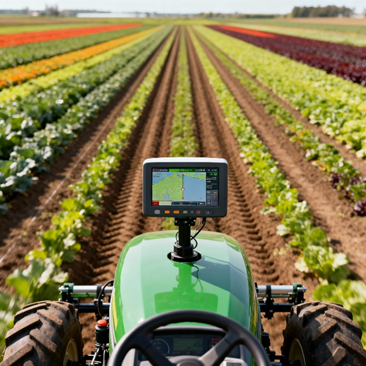
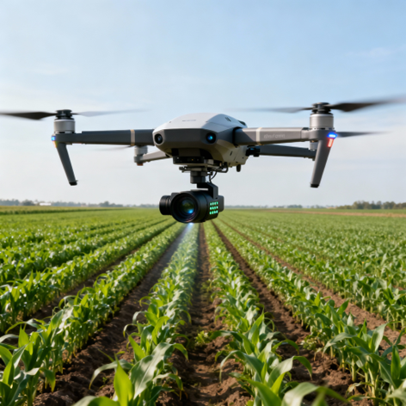
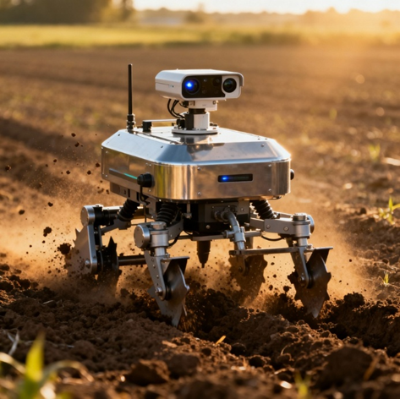
Production Phase: Precision Agriculture Technologies (The Netherlands Model)
GPS & Navigation
Drone Technology
Smart Robotics
Centimeter-level accuracy with dual-antenna GNSS steering (99.9% path accuracy). Autonomous navigation using LiDAR, cameras, and IMU sensors enables 24/7 operations.
AI-powered aerial imagery achieves 85-90% disease detection accuracy. Multispectral cameras cover 100 hectares per flight, generating spot-spray maps that reduce herbicide use by 74%.
AgXeed robots operate 20+ hours daily. GRoW tomato harvesters reduce labor by 80%. Odd.Bot Maverick removes 240,000+ weeds per hectare with 2mm precision—zero chemicals.

Slide 9

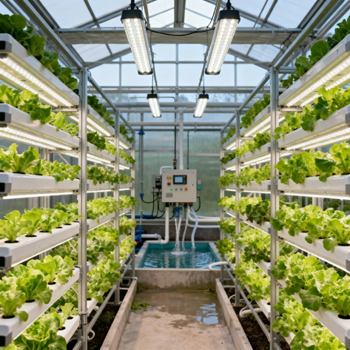
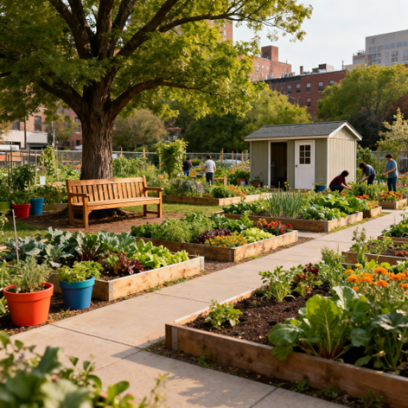

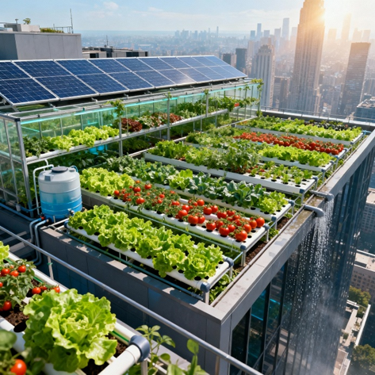

Community Engagement and Space Optimization: Singapore Model
Hydroponic and Aquaponic System
Hydroponic and aquaponic systems enable soil-free farming with efficient nutrient delivery, allowing cultivation in poor or contaminated soils and achieving higher yields through closed-loop nutrient cycling.
Community Garden Initiatives
Singapore’s 1,500+ community gardens promote social engagement, enhance food security, and provide environmental education, integrating agriculture into urban social infrastructure.
Rooftop Agriculture Systems
Rooftop agriculture utilizes underused urban spaces for local food production, reducing heat islands, improving air quality, and localizing supply chains to cut transport costs and emissions (Wood, 2020; Yuan et al., 2024).

Slide 10
Hermetic Solutions
Bio-CO2 controlled
atmosphere
IoT integration in grain silos
The Technology
The Technology
Hermetic storage creates oxygen-depleted, CO₂-enriched atmospheres through natural grain respiration—eliminating fumigants and chemical treatments.
The Technology
The RCC silos in India do not have real-time tracking of the storage atmosphere.
Sensors can track moisture levels, CO2 levels, pests, and temperature.
Use a GPRS module for data transmission. Build smart algorithms to change the atmosphere as per the situation smartly.
Data analytics for detailed reports
RCC silos in India use several chemical fumigants to maintain a controlled atmosphere.
Instead of using toxic fumigants, use bio-CO2 from biogas plants to maintain atmosphere
Less toxicity, longer grain storage
Insect mortality at double the speed on pure CO2
PICS bags: Triple-layer polyethylene for 50-100kg storage
Hermetic cocoons: UV-resistant PVC holding 5-10 MT, rodent-proof with built-in monitoring
Metal silos: Robust, long-lasting large-scale storage
Implementation plan
Implementation plan
Implementation plan
Planning and Partnerships
Procurement and Logistics
Installation and Training
Operation and Maintenance
Evaluation and Scale-up
Sourcing and Infrastructure
Design and Sealing
Monitoring and Quality assurance
Safety and Environmental management
Scale-up and Integration
Pilot and feasibility
Policy Integration
Funding and support
Scaling and Governance
Losses reduction by 90%
1-2 years of storage
100% insect mortality
Faster insect mortality
No seed weight loss
Eco-friendly
Real-time tracking
Automated modifications
Enables quick decisions and actions

Slide 11
Logistics & AI: Optimizing the Supply Chain
01
02
Quality Assessment
Route Optimization
CNN-based image processing at mandis and warehouses enables real-time grading with 88.4% accuracy, reducing post-harvest losses by 10-15%.
Machine learning algorithms for demand forecasting and distribution planning reduce transit delays, fuel consumption by 12%, and emissions by 15%.
03
04
Cold Chain Excellence
Digital Integration
Sensor-controlled temperature and humidity monitoring achieves 22% improvement in perishable goods retention. Blockchain ensures end-to-end traceability.
Platforms connecting farmers to eNAM and AgriStack democratize market access, provide AI-driven pricing analytics, and enable premium market positioning.

Slide 12
Implementation Challenges and Proposed Solutions
Fragmented Supply Chains
Develop integrated farm-to-fork digital platforms and strengthen producer cooperatives.
Data Security and Privacy
Adopt blockchain-based data management and enforce data protection regulations aligned with farmers’ rights.
Infrastructure Deficiencies
Invest in rural broadband expansion, solar-powered IoT devices, and low-bandwidth communication systems.
Digital Literacy Barriers
Implement community-based digital training programs and practical demonstration projects.
Finance and Policy Bottlenecks
Policy incentives must align to reward climate-smart investments

Slide 13
Impact: Transforming Indian Agriculture
67%
20%
20%
20%
Food Savings
Greenhouse Gas
Resource use efficiency
Logistics Efficiency
Post-harvest decision support systems that minimize food loss and operate energy-efficient cold chains have been linked to up to 67% reduction in warehouse waste
Possible reductions of 20-25% in total emissions associated with the supply chain
Digitisation, precision agriculture, and supply chain data integration commonly boost resource use efficiency by 20–50%,
AI-powered logistics yielded positive impacts, with companies reporting reductions in overall logistics costs by 15%
15-25%
20%
Income Growth
Water Savings
Integrated technologies with digital marketplaces forecast 15-25% increase in farmer incomes
Precise, sensor-driven water management can yield water savings of 20–50% compared to traditional practices

Slide 14


Conclusion: The Path Forward
Phase 3: Long-Term (5-10 Years)
Phase 2: Medium-Term (2-5 Years)
Create fully integrated climate-resilient supply chains. Establish national food security networks. Implement sustainability monitoring systems. Develop export capabilities for premium climate-resilient produce.
Phase 1: Immediate (0-2 Years)
Build climate-controlled greenhouse networks. Establish integrated digital supply chain platforms. Implement AI advisory systems and blockchain traceability. Create comprehensive farmer training centers.
Deploy precision irrigation in selected districts. Pilot drone monitoring and greenhouse clusters. Introduce drip systems in water-scarce regions. Launch vertical farming in metropolitan areas.
By synthesizing advanced digital tools with localized storage and logistics innovations, this framework aims to secure India's food supply, strengthen rural livelihoods, and foster sustainable development amid accelerating climate change.

Slide 15


Thank You
FOR YOUR ATTENTION

